Slide 1


Department of Computer Science and Engineering
CS19643 – Foundations of Machine Learning
DETECTING MYCOTOXIN – A DATA DRIVEN APPROACH FOR ENSURING FOOD SAFETY
Deepika SG 210701048
Gopika K V
210701063
Dr.S. Vinodkumar
Professor

Slide 2
Abstract
Our project Mycotoxin Detection in Foods for making sure the safety of the food and Reliability addresses a critical concern in the terms of food security and public health. Mycotoxins these are toxic compounds produced by fungi, producing significant risks to human and animal health when present in food which are then in taken by them. Detecting these contaminants plays important role for ensuring the safety and reliability of food supplies. This project employs the principle working of CNN for detecting specific substances mycotoxin patterns in the food item, to identify mycotoxins in food materials swiftly and accurately. By harnessing the power of CNNs, the project aims to provide food safety officers, farmers, and consumers with timely information regarding the presence of mycotoxins in food products,not only the officials but the accessibility is for public too.

Slide 3
Abstract
Through the integration of machine learning techniques, particularly utilizing datasets related to fungal growth, the project enhances the efficiency and accuracy of mycotoxin detection. Machine learning algorithms analyze vast amounts of data to identify patterns associated with fungal contamination, thereby enabling early detection and intervention measures. By including CNNs and other machine learning concepts, this project not only contributes to the advancement of food safety technologies but also empowers stakeholders across the food supply chain to make informed decisions regarding food quality and safety. Ultimately, the implementation of this innovative approach facilitates proactive measures to mitigate the risks posed by mycotoxins, safeguarding public health and enhancing the reliability of the global food system

Slide 4
Existing System
The existing system for mycotoxin detection in food materials is pivotal for ensuring food safety and reliability. It serves as a critical tool for food safety officers, farmers, and consumers alike, empowering them with vital information about the food they handle and consume. At its core, this system utilizes biosensors, sophisticated devices capable of detecting minute quantities of mycotoxins present in food samples. These biosensors offer rapid and accurate detection, enabling timely intervention to prevent potential health hazards associated with mycotoxin contamination. Furthermore, the integration of machine learning algorithms enhances the system's capabilities by leveraging datasets on fungal growth. By analyzing patterns and trends within these datasets, machine learning algorithms caneffectively identify potential sources of contamination and predict future occurrences.

Slide 5
Proposed System
The incorporation of machine learning algorithms in conjunction with datasets pertaining to fungal growth represents a paradigm shift in the domain of predictive analytics for food safety. By harnessing the power of artificial intelligence, these algorithms can discern intricate patterns within the data, facilitating early detection of fungal contamination and preemptive measures to mitigate mycotoxin accumulation. The machine learning augments its precision and reliability of mycotoxin detection systems, thereby bolstering the resilience of food supply chains against contamination risks.

Slide 6
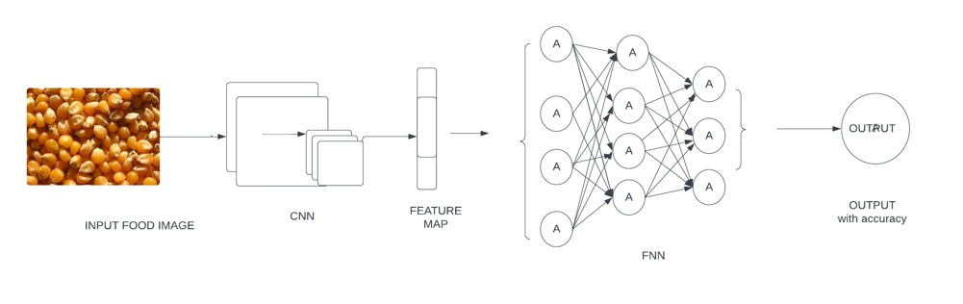
System Architecture

Slide 7
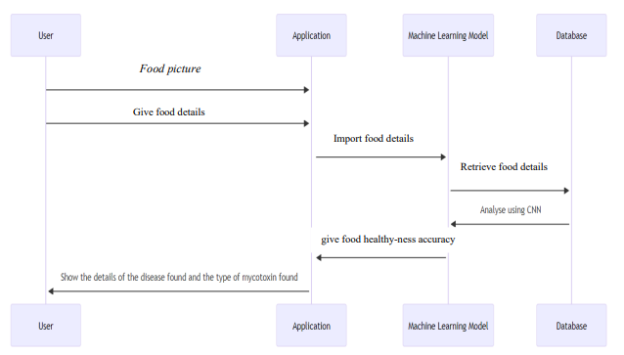
Sequence Diagram

Slide 8
List of Modules
Introduction to Mycotoxin detection
Mycotoxin detection techniques
Integration with Machine Learing
Validation
Impact

Slide 9
Functional Description for each modules
Introduction to Mycotoxin detection: Mycotoxins are harmful compounds produced by fungi that contaminate food, posing serious health risks. This module introduces the significance of detecting mycotoxins in food materials for ensuring food safety. It outlines the importance of this project in aiding food safety officers, farmers, and consumers in identifying and preventing mycotoxin contamination. Furthermore, it emphasizes the utilization of biosensors as a modern approach for mycotoxin detection.

Slide 10
Functional Description of Module
Mycotoxin Detection Techniques:This module delves into various techniques employed for mycotoxin detection, focusing on biosensors. It elucidates the principles behind biosensor technology and its advantages in terms of sensitivity, specificity, and rapidity. Additionally, it discusses the integration of machine learning algorithms to enhance detection accuracy by analyzing datasets related to fungal growth patterns, aiding in early detection and prevention measures

Slide 11
Functional Description of Module
Integration with Machine Learning: This module focuses on the integration of machine learning algorithms in conjunction with biosensors for mycotoxin detection. It explains how machine learning models can analyze complex datasets pertaining to fungal growth dynamics and mycotoxin production, enabling predictive modeling and real-time monitoring. Furthermore, it discusses the training and validation of machine learning models using curated datasets to improve 15 detection sensitivity and specificity

Slide 12
Functional Description of Module
Deployment:Here, the process of deploying biosensor-based mycotoxin detection systems in real-world settings is outlined. It addresses considerations such as sample preparation, on-site detection protocols, and data interpretation. Moreover, it discusses the importance of validation studies to assess the performance and reliability of the detection system under diverse environmental conditions and food matrices. This module also emphasizes the collaboration with stakeholders, including food safety officers and farmers, for field validation.

Slide 13
Functional Description of Module
Impact :The final module explores the potential impact of the project on food safety practices and public health. It highlights the benefits of early mycotoxin detection in mitigating health risks and ensuring food reliability. Additionally, it discusses future directions, such as the development of portable and affordable detection devices, expanding the scope to detect additional food contaminants, and integrating with Machine learning concepts . This module concludes by emphasizing the importance of continuous research and innovation in enhancing food safety measures.

Slide 14
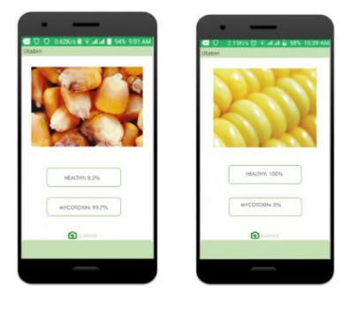
OUTPUT

Slide 15
Conclusion
In conclusion, the implementation of machine learning techniques represents a significant advancement in the field of food safety. By providing timely and reliable detection of mycotoxins, this project empowers food safety officers, farmers, and consumers to make informed decisions regarding food consumption and production practices. Moreover, it underscores the importance of interdisciplinary approaches in addressing complex challenges within the food industry. Looking towards the future, further enhancements and refinements to the existing framework hold immense potential for improving food safety standards on a global scale. Continued research and development efforts can lead to the creation of more sensitive and versatile biosensors capable of detecting an even broader range of mycotoxins across various food matrices

Slide 16
References
https://www.wikipedia.org/
https://www.github.com/
https://www.mail.google.com/
https://www.researchgate.net/
https://www.medium.com/

Slide 17
Thank You

